Slide 1


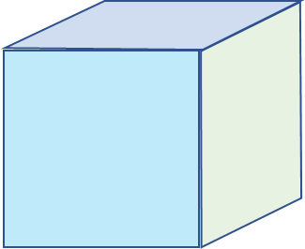
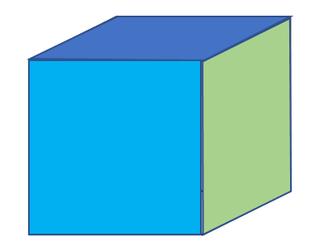
Base number of cubes
Total number of cubes used
1
1
+
3
+
4
+
6
+
10
10
+
20
15
+
35
1
Nth base cubes =
n(n+1)/2
Consider Loop variable i,j to be function scoped not just local loop scoped variable + array is not necessary because only last calculated value is needed
int baseArea(int nCubes) {
int[] ar = new int[10]; // Consider this dynamically increasing not just 10
ar[0] = 1
for(int i=1;i++) {
ar[i] = ar[i-1] + i(i+1)/2 // previous + current
if(ar[i]>>nCubes)
break;
}
// int i would have added extra base to array before loop break
// also here i gives max height of the cube
int extraCubes = nCubes - ar[i-1] ;
if(extraCubes==0)
return ar[i-1];
for(int j=1;j++) {
if ( j(j+1)/2 >= extraCubes )
break;
}
Return ar[i-1]+j;
}
1 extra cube= 1space
“” = 2 space
“” = 2 space
“” = 3 space
“” = 3 space
“” = 3 space
“” = 4 space
j(j+1)/2 will return these shaded blue part
If Number of extra cubes = 1 2,3 4,5,6 7,8,9,10 11,12,13,14,15 …..
Space taken = 1 2 3 4 5 …..
Value of j

Slide 2
